Slide 1
Chapter 4
Threads
Operating Systems:
Internals and Design Principles
Seventh Edition
By William Stallings
Notes:
“Operating Systems: Internal and Design Principles”, 7/e, by William Stallings, Chapter 4 “Threads”.

Slide 2

Operating Systems:
Internals and Design Principles
The basic idea is that the several components in any complex system will perform particular subfunctions that contribute to the overall function.
—THE SCIENCES OF THE ARTIFICIAL,
Herbert Simon
Notes:
This chapter examines some more advanced concepts related to process management, which are found in a number of contemporary operating systems. We show that the concept of process is more complex and subtle than presented so far and in fact embodies two separate and potentially independent concepts: one relating to resource ownership and another relating to execution. This distinction has led to the development, in many operating systems, of a construct known as the thread .

Slide 3
Processes and Threads
Traditional processes have two characteristics:
Resource Ownership
Scheduling/Execution
  Process includes a virtual address space to hold the process image
    the OS provides protection to prevent unwanted interference between processes with respect to resources
Follows an execution path that may be interleaved with other processes
  a process has an execution state (Running, Ready, etc.) and a dispatching priority and is scheduled and dispatched by the OS
  Traditional processes are sequential; i.e. only one execution path

Slide 4

Processes and Threads
Multithreading - The ability of an OS to support multiple, concurrent paths of execution within a single process
The unit of resource ownership is referred to as a process or task
The unit of dispatching is referred to as a thread or lightweight process
Notes:
To distinguish the two characteristics, the unit of dispatching is usually referred to as a thread or lightweight process , while the unit of resource ownership is usually referred to as a process or task .
Multithreading refers to the ability of an OS to support multiple, concurrent paths of execution within a single process.

Slide 5
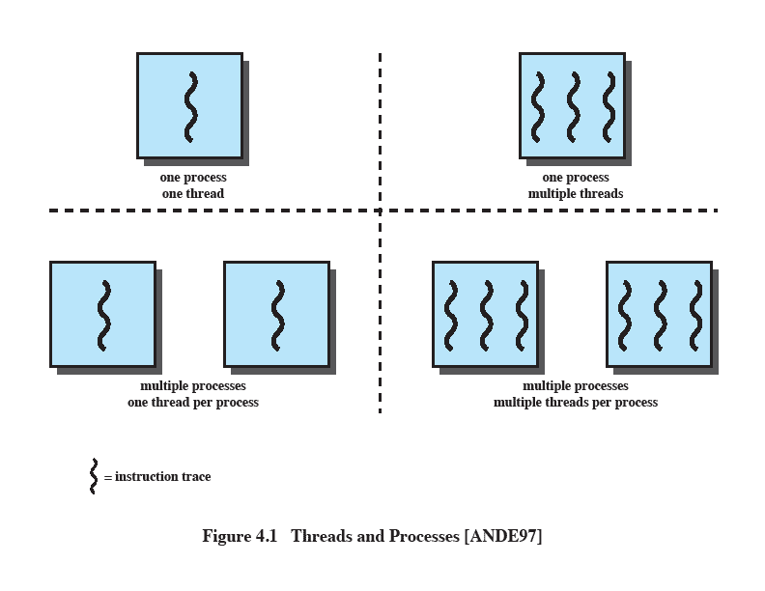
Single Threaded Approaches
A single execution path per process, in which the concept of a thread is not recognized, is referred to as a single-threaded approach
MS-DOS, some versions of UNIX supported only this type of process.
Notes:
The traditional approach of a single thread of execution per process, in which the concept of a thread is not recognized, is referred to as a single-threaded approach. The two arrangements shown in the left half of Figure 4.1 are single-threaded approaches. MS-DOS is an example of an OS that supports a single user process and a single thread.

Slide 6
Multithreaded Approaches
The right half of Figure 4.1 depicts multithreaded approaches
A Java run-time environment is a system of one process with multiple threads; Windows, some UNIXes, support multiple multithreaded processes.
Notes:
The right half of Figure 4.1 depicts multithreaded approaches. A Java run-time environment is an example of a system of one process with multiple threads. Of interest in this section is the use of multiple processes, each of which supports multiple threads. This approach is taken in Windows, Solaris, and many modern versions of UNIX, among others. In this section we give a general description of multithreading; the details of the Windows, Solaris, and Linux approaches are discussed later in this chapter.

Slide 7

Processes
In a multithreaded environment the process is the unit that owns resources and the unit of protection.
  i.e., the OS provides protection at the process level
Processes have
  A virtual address space that holds the process image
  Protected access to
  processors
  other processes
  files
  I/O resources
Notes:
In a multithreaded environment, a process is defined as the unit of resource allocation and a unit of protection. The following are associated with processes:
• A virtual address space that holds the process image
• Protected access to processors, other processes (for interprocess communication), files, and I/O resources (devices and channels)

Slide 8

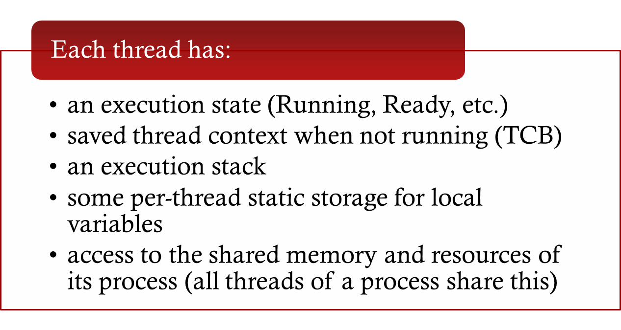
One or More Threads in a Process
Notes:
Within a process, there may be one or more threads, each with the following:
• A thread execution state (Running, Ready, etc.)
• A saved thread context when not running; one way to view a thread is as an independent program counter operating within a process
• An execution stack
• Some per-thread static storage for local variables
• Access to the memory and resources of its process, shared with all other threads in that process

Slide 9
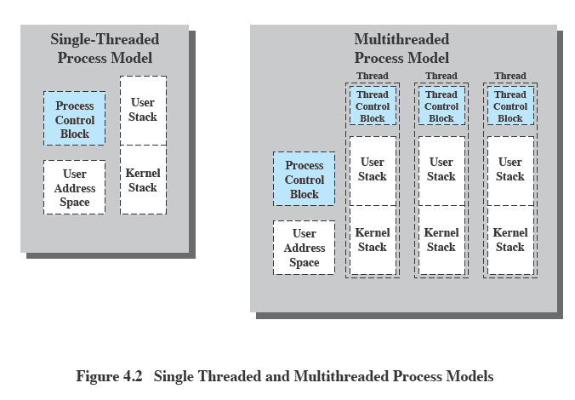
Threads vs. Processes
Notes:
Figure 4.2 illustrates the distinction between threads and processes from the point of view of process management. In a single-threaded process model (i.e., there is no distinct concept of thread), the representation of a process includes its process control block and user address space, as well as user and kernel stacks to manage the call/return behavior of the execution of the process. While the process is running, it controls the processor registers. The contents of these registers are saved when the process is not running. In a multithreaded environment, there is still a single process control block and user address space associated with the process, but now there are separate stacks for each thread, as well as a separate control block for each thread containing register values, priority, and other thread-related state information.

Slide 10
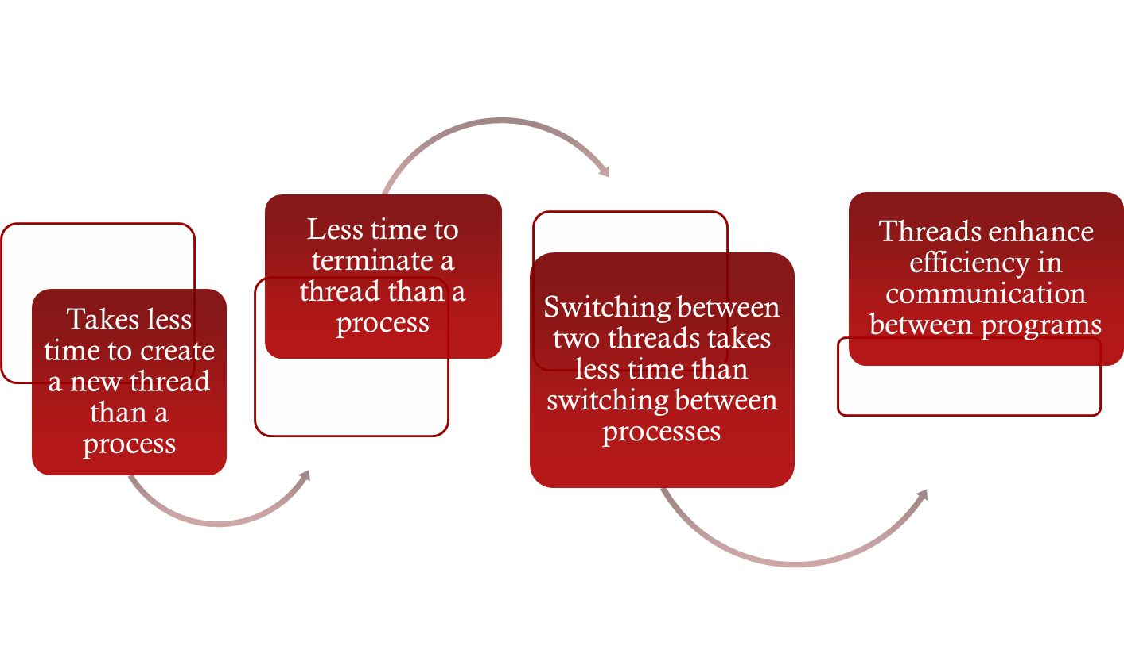
Benefits of Threads
Notes:
Thus, all of the threads of a process share the state and resources of that process. They reside in the same address space and have access to the same data. When one thread alters an item of data in memory, other threads see the results if and when they access that item. If one thread opens a file with read privileges, other threads in the same process can also read from that file.
The key benefits of threads derive from the performance implications:
1. It takes far less time to create a new thread in an existing process than to
create a brand-new process. Studies done by the Mach developers show that
thread creation is ten times faster than process creation in UNIX [TEVA87].
2. It takes less time to terminate a thread than a process.
3. It takes less time to switch between two threads within the same process than to switch between processes.
4. Threads enhance efficiency in communication between different executing programs. In most operating systems, communication between independent processes requires the intervention of the kernel to provide protection and the mechanisms needed for communication. However, because threads within the same process share memory and files, they can communicate with each other without invoking the kernel.
Thus, if there is an application or function that should be implemented as a set of related units of execution, it is far more efficient to do so as a collection of threads rather than a collection of separate processes.

Slide 11

Thread Use in a
Single-User System
Foreground and background work
Asynchronous processing
Speed of execution
Modular program structure
Notes:
[LETW88] gives four examples of the uses of threads in a single-user multiprocessing system:
• Foreground and background work: For example, in a spreadsheet program,
one thread could display menus and read user input, while another thread executes user commands and updates the spreadsheet. This arrangement often increases the perceived speed of the application by allowing the program to prompt for the next command before the previous command is complete.
• Asynchronous processing: Asynchronous elements in the program can be
implemented as threads. For example, as a protection against power failure, one can design a word processor to write its random access memory (RAM) buffer to disk once every minute. A thread can be created whose sole job is periodic backup and that schedules itself directly with the OS; there is no need for fancy code in the main program to provide for time checks or to coordinate input and output.
• Speed of execution: A multithreaded process can compute one batch of data
while reading the next batch from a device. On a multiprocessor system, multiple threads from the same process may be able to execute simultaneously. Thus, even though one thread may be blocked for an I/O operation to read in a batch of data, another thread may be executing.
• Modular program structure: Programs that involve a variety of activities or a
variety of sources and destinations of input and output may be easier to design and implement using threads.

Slide 12

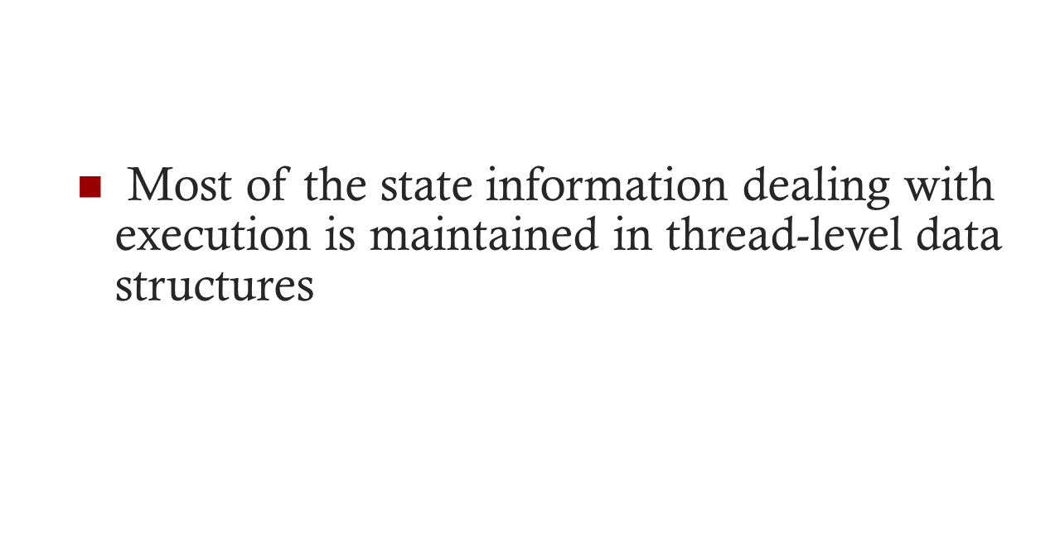

In an OS that supports threads, scheduling and dispatching is done on a thread basis
  suspending a process involves suspending all threads of the process
  termination of a process terminates all threads within the process
Notes:
In an OS that supports threads, scheduling and dispatching is done on a thread basis; hence, most of the state information dealing with execution is maintained in thread-level data structures. There are, however, several actions that affect all of the threads in a process and that the OS must manage at the process level. For example, suspension involves swapping the address space of one process out of main memory to make room for the address space of another process. Because all threads in a process share the same address space, all threads are suspended at the same time. Similarly, termination of a process terminates all threads within that process.

Slide 13

Thread operations associated with a change in thread state are:
      Spawn (create)
      Block
      Unblock
      Finish
The key states for
a thread are:
      Running
      Ready
      Blocked
Notes:
THREAD STATES
As with processes, the key states for a thread are Running, Ready, and Blocked. Generally, it does not make sense to associate suspend states with threads because such states are process-level concepts. In particular, if a process is swapped out, all of its threads are necessarily swapped out because they all share the address space of the process. There are four basic thread operations associated with a change in thread state [ANDE04]:
• Spawn: Typically, when a new process is spawned, a thread for that process is also spawned. Subsequently, a thread within a process may spawn another thread within the same process, providing an instruction pointer and arguments for the new thread. The new thread is provided with its own register context and stack space and placed on the ready queue.
• Block: When a thread needs to wait for an event, it will block (saving its user registers, program counter, and stack pointers). The processor may now turn to the execution of another ready thread in the same or a different process.
• Unblock: When the event for which a thread is blocked occurs, the thread is moved to the Ready queue.
• Finish: When a thread completes, its register context and stacks are deallocated.

Slide 14

A key issue with threads is whether or not they can be scheduled independently of the process to which they belong.
Or, is it possible to block one thread in a process without blocking the entire process?
  If not, then much of the flexibility of threads is lost.
Notes:
THREAD STATES
As with processes, the key states for a thread are Running, Ready, and Blocked. Generally, it does not make sense to associate suspend states with threads because such states are process-level concepts. In particular, if a process is swapped out, all of its threads are necessarily swapped out because they all share the address space of the process. There are four basic thread operations associated with a change in thread state [ANDE04]:
• Spawn: Typically, when a new process is spawned, a thread for that process is also spawned. Subsequently, a thread within a process may spawn another thread within the same process, providing an instruction pointer and arguments for the new thread. The new thread is provided with its own register context and stack space and placed on the ready queue.
• Block: When a thread needs to wait for an event, it will block (saving its user registers, program counter, and stack pointers). The processor may now turn to the execution of another ready thread in the same or a different process.
• Unblock: When the event for which a thread is blocked occurs, the thread is moved to the Ready queue.
• Finish: When a thread completes, its register context and stacks are deallocated.

Slide 15
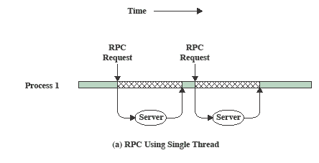
RPC Using Single Thread
Notes:
A significant issue is whether the blocking of a thread results in the blocking of the entire process. In other words, if one thread in a process is blocked, does this prevent the running of any other thread in the same process even if that other thread is in a ready state? Clearly, some of the flexibility and power of threads is lost if the one blocked thread blocks an entire process.
We return to this issue subsequently in our discussion of user-level versus kernel-level threads, but for now let us consider the performance benefits of threads that do not block an entire process. Figure 4.3 (based on one in [KLEI96]) shows a program that performs two remote procedure calls (RPCs) 2 to two different hosts to obtain a combined result. In a single-threaded program, the results are obtained in sequence, so the program has to wait for a response from each server in turn. Rewriting the program to use a separate thread for each RPC results in a substantial speedup. Note that if this program operates on a uniprocessor, the requests must be generated sequentially and the results processed in sequence; however, the program waits concurrently for the two replies.

Slide 16
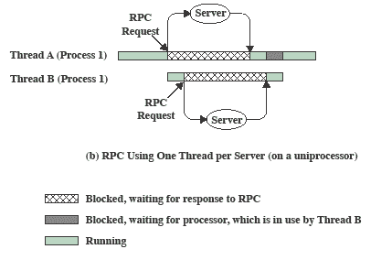
RPC Using One
Thread per Server
Notes:
Rewriting the program to use a separate thread for each RPC results in a substantial speedup.
Note that if this program operates on a uniprocessor, the requests must be generated sequentially and the results processed in sequence;
however, the program waits concurrently for the two replies.

Slide 17
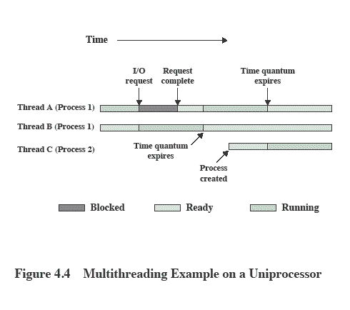

Multithreading on a Uniprocessor
Notes:
On a uniprocessor, multiprogramming enables the interleaving of multiple threads within multiple processes. In the example of Figure 4.4 , three threads in two processes are interleaved on the processor. Execution passes from one thread to another either when the currently running thread is blocked or when its time slice is exhausted.

Slide 18
Thread Synchronization
It is necessary to synchronize the activities of the various threads
      all threads of a process share the same address space and other resources
      any alteration of a resource by one thread affects the other threads in the same process
Notes:
THREAD SYNCHRONIZATION
All of the threads of a process share the same address space and other resources, such as open files. Any alteration of a resource by one thread affects the environment of the other threads in the same process. It is therefore necessary to synchronize the activities of the various threads so that they do not interfere with each other or corrupt data structures. For example, if two threads each try to add an element to a doubly linked list at the same time, one element may be lost or the list may end up malformed. The issues raised and the techniques used in the synchronization of threads are, in general, the same as for the synchronization of processes. These issues and techniques are the subject of Chapters 5 and 6 .

Slide 19
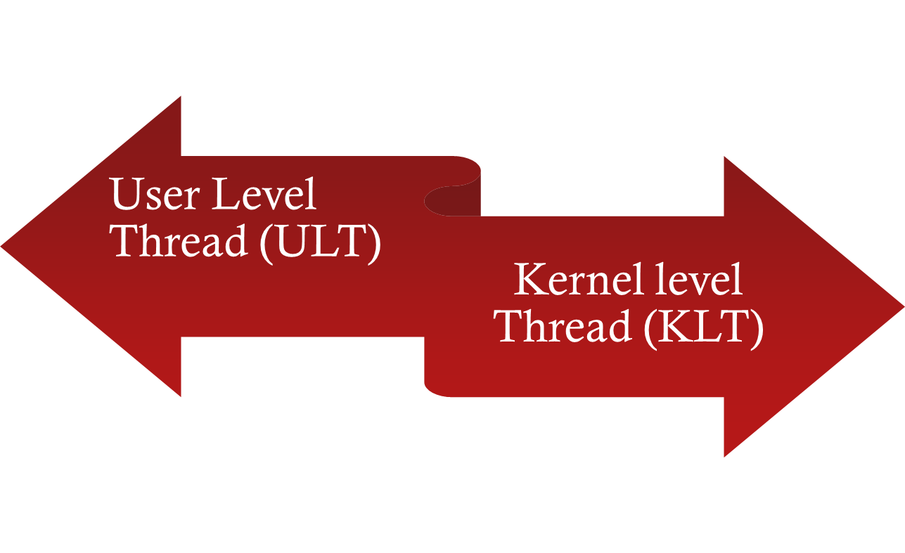

Types of Threads
NOTE: we are talking about threads for user processes. Both ULT & KLT execute in user mode. An OS may also have threads but that is not what we are discussing here.
Notes:
User-Level and Kernel-Level Threads
There are two broad categories of thread implementation: user-level threads (ULTs) and kernel-level threads (KLTs). The latter are also referred to in the literature as kernel-supported threads or lightweight processes.

Slide 20
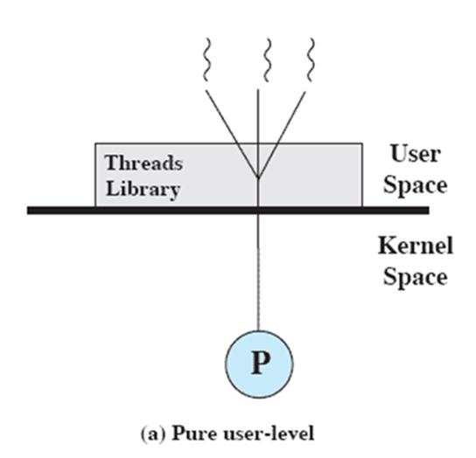
User-Level Threads (ULTs)
Thread management is done by the application
The kernel is not aware of the existence of threads
Not the kind we’ve discussed so far.
Notes:
USER-LEVEL THREADS
In a pure ULT facility, all of the work of thread management is done by the application and the kernel is not aware of the existence of threads. Figure 4.5a illustrates the pure ULT approach. Any application can be programmed to be multithreaded by using a threads library, which is a package of routines for ULT management. The threads library contains code for creating and destroying threads, for passing messages and data between threads, for scheduling thread execution, and for saving and restoring thread contexts.
By default, an application begins with a single thread and begins running in that thread. This application and its thread are allocated to a single process managed by the kernel. At any time that the application is running (the process is in the Running state), the application may spawn a new thread to run within the same process. Spawning is done by invoking the spawn utility in the threads library. Control is passed to that utility by a procedure call. The threads library creates a data structure for the new thread and then passes control to one of the threads within this process that is in the Ready state, using some scheduling algorithm. When control is passed to the library, the context of the current thread is saved, and when control is passed from the library to a thread, the context of that thread is restored. The context essentially consists of the contents of user registers, the program counter, and stack pointers.

Slide 21
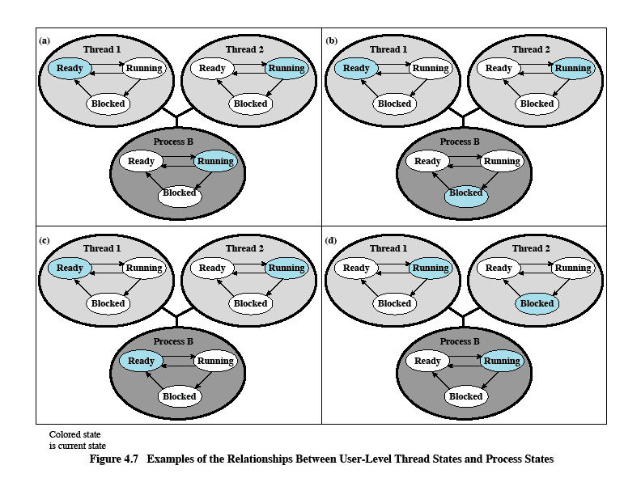
Relationships Between ULT
States and Process States
Possible transitions from 4.6a:
4.6a→4.6b
4.6a→4.6c
4.6a→4.6d
Figure 4.6 Examples of the Relationships between User-Level Thread States and Process States
Notes:
All of the activity described in the preceding paragraph takes place in user space and within a single process. The kernel is unaware of this activity. The kernel continues to schedule the process as a unit and assigns a single execution state (Ready, Running, Blocked, etc.) to that process. The following examples should clarify the relationship between thread scheduling and process scheduling. Suppose that process B is executing in its thread 2; the states of the process and two ULTs that are part of the process are shown in Figure 4.6a . Each of the following is a possible occurrence:
1. The application executing in thread 2 makes a system call that blocks B. For
example, an I/O call is made. This causes control to transfer to the kernel. The kernel invokes the I/O action, places process B in the Blocked state, and switches to another process. Meanwhile, according to the data structure maintained by the threads library, thread 2 of process B is still in the Running state. It is important to note that thread 2 is not actually running in the sense of being executed on a processor; but it is perceived as being in the Running state by the threads library. The corresponding state diagrams are shown in Figure 4.6b .
2. A clock interrupt passes control to the kernel and the kernel determines
that the currently running process (B) has exhausted its time slice. The kernel places process B in the Ready state and switches to another process. Meanwhile, according to the data structure maintained by the threads library, thread 2 of process B is still in the Running state. The corresponding state diagrams are shown in Figure 4.6c .
3. Thread 2 has reached a point where it needs some action performed by thread
1 of process B. Thread 2 enters a Blocked state and thread 1 transitions from Ready to Running. The process itself remains in the Running state. The corresponding state diagrams are shown in Figure 4.6d .
In cases 1 and 2 ( Figures 4.6b and 4.6c ), when the kernel switches control back to process B, execution resumes in thread 2. Also note that a process can be interrupted, either by exhausting its time slice or by being preempted by a higher priority process, while it is executing code in the threads library. Thus, a process may be in the midst of a thread switch from one thread to another when interrupted. When that process is resumed, execution continues within the threads library, which completes the thread switch and transfers control to another thread within that process.

Slide 22

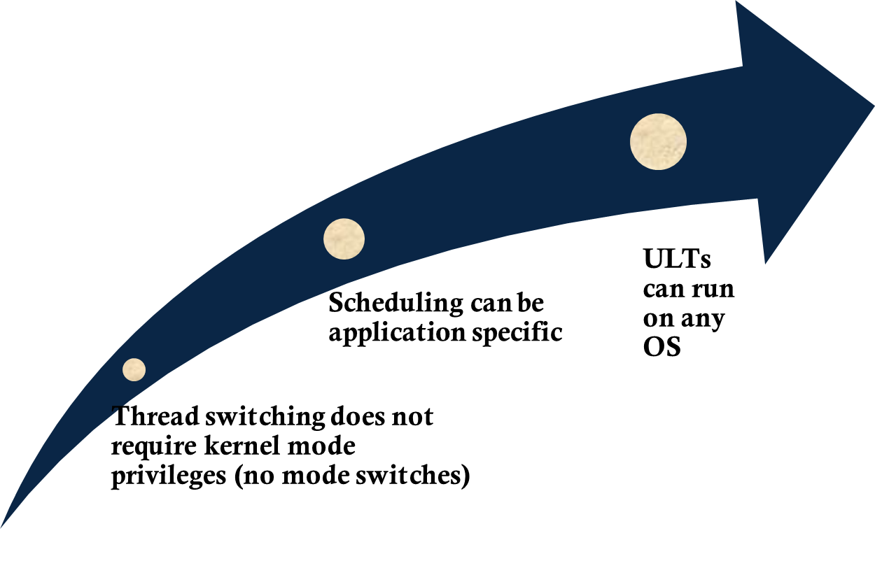
Notes:
There are a number of advantages to the use of ULTs instead of KLTs, including the following:
1. Thread switching does not require kernel mode privileges because all of the
thread management data structures are within the user address space of a single process. Therefore, the process does not switch to the kernel mode to do thread management. This saves the overhead of two mode switches (user to kernel; kernel back to user).
2. Scheduling can be application specific. One application may benefit most
from a simple round-robin scheduling algorithm, while another might benefit from a priority-based scheduling algorithm. The scheduling algorithm can be tailored to the application without disturbing the underlying OS scheduler.
3. ULTs can run on any OS. No changes are required to the underlying kernel
to support ULTs. The threads library is a set of application-level functions shared by all applications.

Slide 23

Disadvantages of ULTs
In a typical OS many system calls are blocking
    as a result, when a ULT executes a system call, not only is that thread blocked, but all of the threads within the process are blocked
In a pure ULT strategy, a multithreaded application cannot take advantage of multiprocessing
Notes:
There are two distinct disadvantages of ULTs compared to KLTs:
1. In a typical OS, many system calls are blocking. As a result, when a ULT
executes a system call, not only is that thread blocked, but also all of the threads within the process are blocked.
2. In a pure ULT strategy, a multithreaded application cannot take advantage
of multiprocessing. A kernel assigns one process to only one processor at a time. Therefore, only a single thread within a process can execute at a time. In effect, we have application-level multiprogramming within a single process. While this multiprogramming can result in a significant speedup of the application, there are applications that would benefit from the ability to execute portions of code simultaneously.

Slide 24
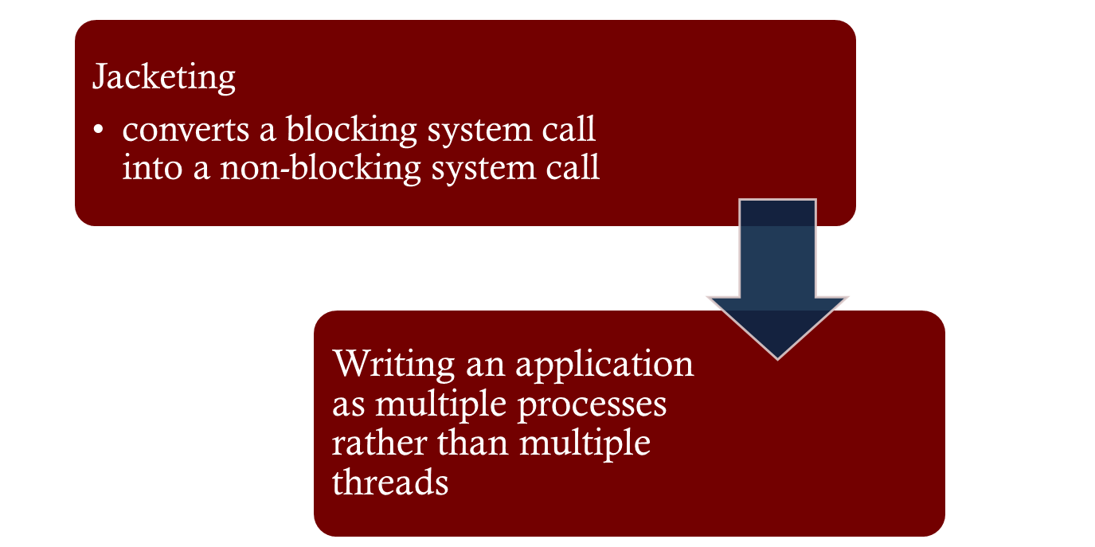

Overcoming ULT Disadvantages
Notes:
There are ways to work around these two problems. For example, both problems can be overcome by writing an application as multiple processes rather than multiple threads. But this approach eliminates the main advantage of threads: Each switch becomes a process switch rather than a thread switch, resulting in much
greater overhead. Another way to overcome the problem of blocking threads is to use a technique referred to as jacketing . The purpose of jacketing is to convert a blocking
system call into a non-blocking system call. For example, instead of directly calling a system I/O routine, a thread calls an application-level I/O jacket routine. Within this jacket routine is code that checks to determine if the I/O device is busy. If it is, the thread enters the Blocked state and passes control (through the threads library) to another thread. When this thread later is given control again, the jacket routine checks the I/O device again.

Slide 25
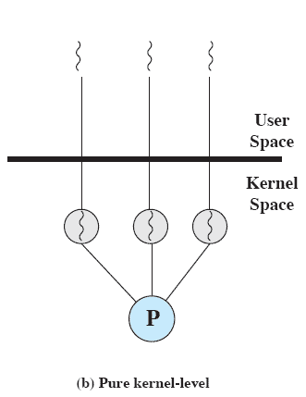
Kernel-Level Threads (KLTs)
  Thread management is done by the kernel (could call them KMT)
      no thread management is done by the application
    Windows is an example of this approach
Notes:
KERNEL-LEVEL THREADS
In a pure KLT facility, all of the work of thread management is done by the kernel. There is no thread management code in the application level, simply an application programming interface (API) to the kernel thread facility. Windows is an example of this approach. Figure 4.5b depicts the pure KLT approach. The kernel maintains context
information for the process as a whole and for individual threads within the process.

Slide 26
Advantages of KLTs
The kernel can simultaneously schedule multiple threads from the same process on multiple processors
If one thread in a process is blocked, the kernel can schedule another thread of the same process
Notes:
Scheduling by the kernel is done on a thread basis. This approach overcomes the two principal drawbacks of the ULT approach. First, the kernel can simultaneously schedule multiple threads from the same process on multiple processors. Second, if one thread in a process is blocked, the kernel can schedule another thread of the same process. Another advantage of the KLT approach is that kernel routines themselves can be multithreaded.

Slide 27
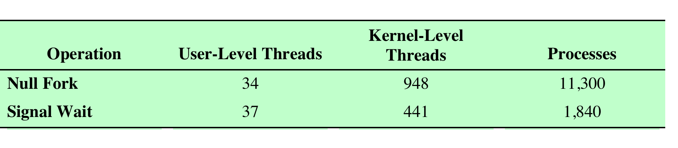

Disadvantage of KLTs
The transfer of control from one thread to another within the same process requires a mode switch to the kernel
Notes:
The principal disadvantage of the KLT approach compared to the ULT approach is that the transfer of control from one thread to another within the same process requires a mode switch to the kernel. To illustrate the differences, Table 4.1 shows the results of measurements taken on a uniprocessor VAX computer running a UNIX-like OS. The two benchmarks are as follows: Null Fork, the time to create, schedule, execute, and complete a process/thread that invokes the null procedure (i.e., the overhead of forking a process/thread); and Signal-Wait, the time for a process/thread to signal a waiting process/thread and then wait on a condition (i.e., the overhead of synchronizing two processes/threads together). We see that there is
an order of magnitude or more of difference between ULTs and KLTs and similarly between KLTs and processes.

Slide 28
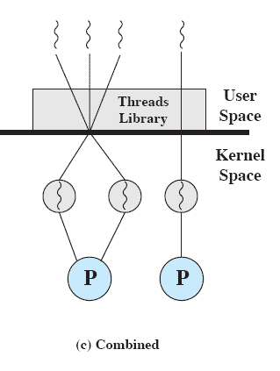
Combined Approaches
Thread creation is done in the user space
Bulk of scheduling and synchronization of threads is by the application
Solaris is an example
Notes:
COMBINED APPROACHES
Some operating systems provide a combined ULT/ KLT facility ( Figure 4.5c ). In a combined system, thread creation is done completely in user space, as is the bulk of the scheduling and synchronization of threads within an application. The multiple ULTs from a single application are mapped onto some (smaller or equal) number of KLTs. The programmer may
adjust the number of KLTs for a particular application and processor to achieve the best overall results. In a combined approach, multiple threads within the same application can run in parallel on multiple processors, and a blocking system call need not block the entire process. If properly designed, this approach should combine the advantages of the pure ULT and KLT approaches while minimizing the disadvantages. Solaris is a good example of an OS using this combined approach. The current Solaris version limits the ULT/KLT relationship to be one-to-one.

Slide 29
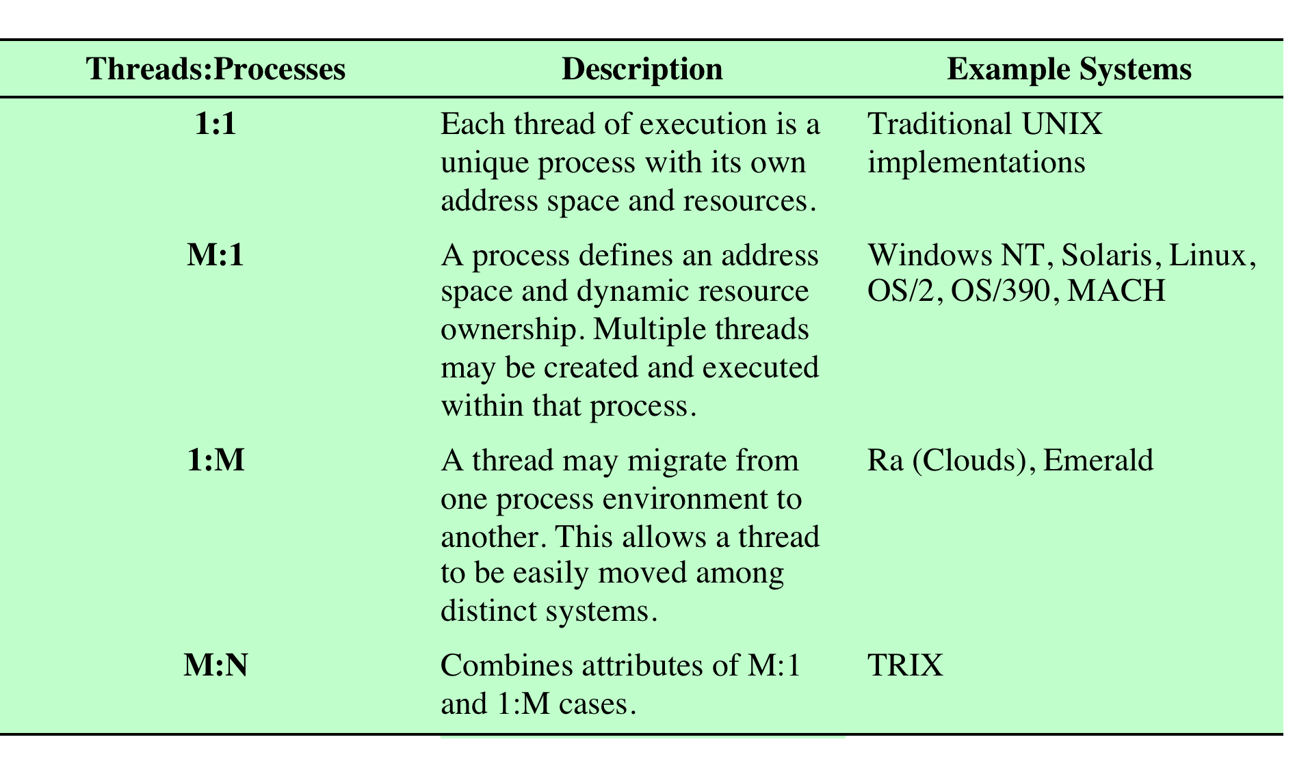
Relationship Between
Threads and Processes
Table 4.2 Relationship between Threads and Processes
Notes:
As we have said, the concepts of resource allocation and dispatching unit have traditionally been embodied in the single concept of the process—that is, as a 1 : 1
relationship between threads and processes. Recently, there has been much interest in providing for multiple threads within a single process, which is a many-toone
relationship. However, as Table 4.2 shows, the other two combinations have also been investigated, namely, a many-to-many relationship and a one-to-many relationship.
The idea of having a many-to-many relationship between threads and processes has been explored in the experimental operating system TRIX [PAZZ92, WARD80]. In TRIX, there are the concepts of domain and thread. A domain is a static entity, consisting of an address space and “ports” through which messages may be sent and received. A thread is a single execution path, with an execution stack, processor state, and scheduling information.
As with the multithreading approaches discussed so far, multiple threads may execute in a single domain, providing the efficiency gains discussed earlier. However, it is also possible for a single user activity, or application, to be performed in multiple domains. In this case, a thread exists that can move from one domain to another.

Slide 30
Multiple Cores & Multithreading
Multithreading and multicore chips have the potential to improve performance of applications that have large amounts of parallelism
Gaming, simulations, etc. are examples
Performance doesn’t necessarily scale linearly with the number of cores …
Notes:
The potential performance benefits of a multicore organization depend on the ability to effectively exploit the parallel resources available to the application. Let us focus first on a single application running on a multicore system. Amdahl’s law (see Appendix E ) states that:
Speedup = time to execute program on a single processor time to execute program on N parallel processors
= 1 (1 - f ) + f N
The law assumes a program in which a fraction (1 - f) of the execution time involves code that is inherently serial and a fraction f that involves code that is infinitely
parallelizable with no scheduling overhead. This law appears to make the prospect of a multicore organization attractive. But as Figure 4.7a shows, even a small amount of serial code has a noticeable impact. If only 10% of the code is inherently serial ( f = 0.9) , running the program on a multicore system with eight processors yields a performance gain of only a factor of 4.7. In addition, software typically incurs overhead as a result of communication and distribution of work to multiple processors and cache coherence overhead. This
results in a curve where performance peaks and then begins to degrade because of the increased burden of the overhead of using multiple processors. Figure 4.7b ,
from [MCDO07], is a representative example.
However, software engineers have been addressing this problem and there are numerous applications in which it is possible to effectively exploit a multicore system. [MCDO07] reports on a set of database applications, in which great attention

Slide 31
Amdahl’s Law
Speedup depends on the amount of code that must be executed sequentially
Formula:
  Speedup = time to run on single processor
  time to execute on N || processors
  1
  = (1 – f) + f / N
  (where f is the amount of parallelizable code)
Notes:
The potential performance benefits of a multicore organization depend on the ability to effectively exploit the parallel resources available to the application. Let us focus first on a single application running on a multicore system. Amdahl’s law (see Appendix E ) states that:
Speedup = time to execute program on a single processor time to execute program on N parallel processors
= 1 (1 - f ) + f N
The law assumes a program in which a fraction (1 - f) of the execution time involves code that is inherently serial and a fraction f that involves code that is infinitely
parallelizable with no scheduling overhead. This law appears to make the prospect of a multicore organization attractive. But as Figure 4.7a shows, even a small amount of serial code has a noticeable impact. If only 10% of the code is inherently serial ( f = 0.9) , running the program on a multicore system with eight processors yields a performance gain of only a factor of 4.7. In addition, software typically incurs overhead as a result of communication and distribution of work to multiple processors and cache coherence overhead. This
results in a curve where performance peaks and then begins to degrade because of the increased burden of the overhead of using multiple processors. Figure 4.7b ,
from [MCDO07], is a representative example.
However, software engineers have been addressing this problem and there are numerous applications in which it is possible to effectively exploit a multicore system. [MCDO07] reports on a set of database applications, in which great attention

Slide 32
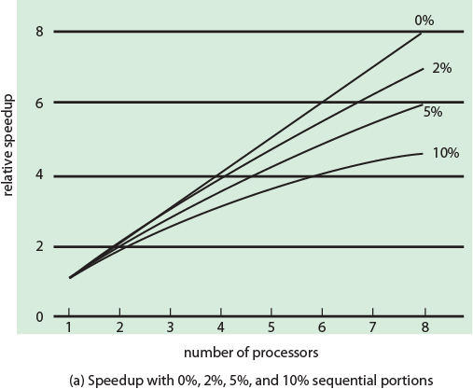
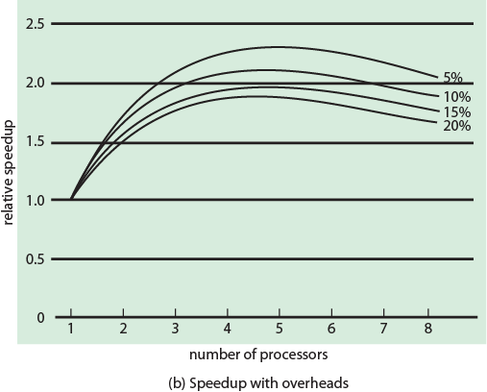
Performance Effect of Multiple Cores
Figure 4.7 (a)
Figure 4.7 (b)
Notes:
The potential performance benefits of a multicore organization depend on the ability to effectively exploit the parallel resources available to the application. Let us focus first on a single application running on a multicore system. Amdahl’s law (see Appendix E ) states that:
Speedup = time to execute program on a single processor time to execute program on N parallel processors
= 1 (1 - f ) + f N
The law assumes a program in which a fraction (1 - f) of the execution time involves code that is inherently serial and a fraction f that involves code that is infinitely
parallelizable with no scheduling overhead. This law appears to make the prospect of a multicore organization attractive. But as Figure 4.7a shows, even a small amount of serial code has a noticeable impact. If only 10% of the code is inherently serial ( f = 0.9) , running the program on a multicore system with eight processors yields a performance gain of only a factor of 4.7. In addition, software typically incurs overhead as a result of communication and distribution of work to multiple processors and cache coherence overhead. This
results in a curve where performance peaks and then begins to degrade because of the increased burden of the overhead of using multiple processors. Figure 4.7b ,
from [MCDO07], is a representative example.
However, software engineers have been addressing this problem and there are numerous applications in which it is possible to effectively exploit a multicore system. [MCDO07] reports on a set of database applications, in which great attention

Slide 33
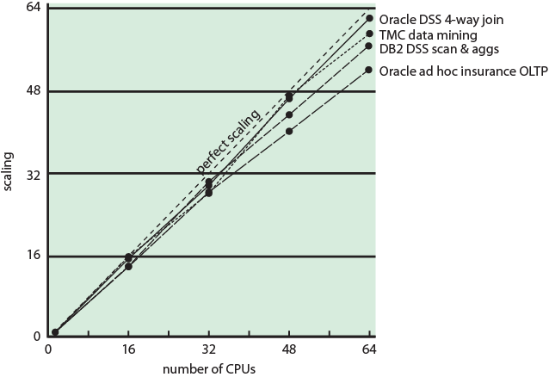
Database Workloads on
Multiple-Processor Hardware
Figure 4.8 Scaling of Database Workloads on Multiple Processor Hardware
Notes:
However, software engineers have been addressing this problem and there are numerous applications in which it is possible to effectively exploit a multicore system. [MCDO07] reports on a set of database applications, in which great attention was paid to reducing the serial fraction within hardware architectures, operating systems, middleware, and the database application software. Figure 4.8 shows the result. As this example shows, database management systems and database applications are one area in which multicore systems can be used effectively. Many kinds of servers can also effectively use the parallel multicore organization, because servers typically handle numerous relatively independent transactions in parallel.

Slide 34
Applications That Benefit
[MCDO06]
Multithreaded native applications
    characterized by having a small number of highly threaded processes
Multiprocess applications
    characterized by the presence of many single-threaded processes
Java applications
Multi-instance applications
    multiple instances of the application in parallel
Notes:
In addition to general-purpose server software, a number of classes of applications benefit directly from the ability to scale throughput with the number of cores. [MCDO06] lists the following examples:
• Multithreaded native applications:
Multithreaded applications are characterized by having a small number of highly threaded processes. Examples of threaded applications include Lotus Domino or Siebel CRM (Customer Relationship Manager).
• Multiprocess applications:
Multiprocess applications are characterized by the presence of many single-threaded processes. Examples of multiprocess applications include the Oracle database, SAP, and PeopleSoft.
• Java applications:
Java applications embrace threading in a fundamental way. Not only does the Java language greatly facilitate multithreaded applications, but the Java Virtual Machine is a multithreaded process that provides scheduling and memory management for Java applications. Java applications that can benefit directly from multicore resources include application servers such
as Sun’s Java Application Server, BEA’s Weblogic, IBM’s Websphere, and the open-source Tomcat application server. All applications that use a Java 2 Platform, Enterprise Edition (J2EE platform) application server can immediately benefit from multicore technology.
Multiinstance applications:
Even if an individual application does not scale to take advantage of a large number of threads, it is still possible to gain from multicore architecture by running multiple instances of the application in parallel. If multiple application instances require some degree of isolation, virtualization technology (for the hardware of the operating system) can be used to provide each of them with its own separate and secure environment.

Slide 35

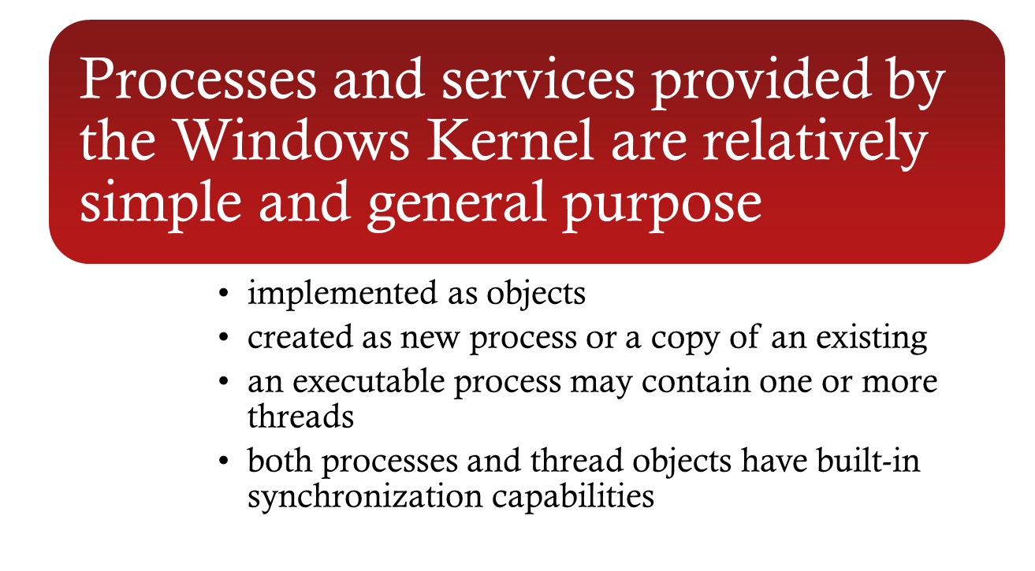

Notes:
Windows process design is driven by the need to provide support for a variety of OS environments. Processes supported by different OS environments differ in a number
of ways, including the following:
• How processes are named
• Whether threads are provided within processes
• How processes are represented
• How process resources are protected
• What mechanisms are used for interprocess communication and synchronization
• How processes are related to each other
Accordingly, the native process structures and services provided by the Windows Kernel are relatively simple and general purpose, allowing each OS subsystem to emulate a particular process structure and functionality. Important characteristics of Windows processes are the following:
• Windows processes are implemented as objects.
• A process can be created as new process, or as a copy of an existing process.
• An executable process may contain one or more threads.
• Both process and thread objects have built-in synchronization capabilities.

Slide 36
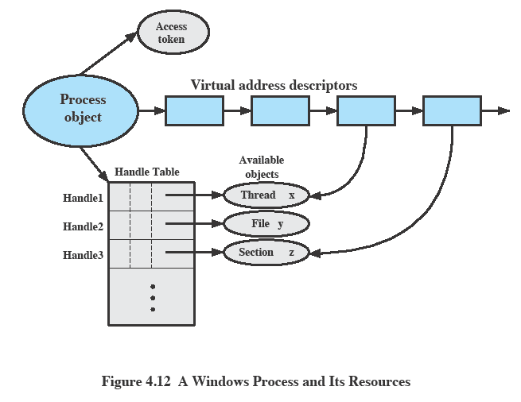
Relationship Between
Process and Resource
Figure 4.10 A Windows Process and Its Resources
Notes:
Figure 4.10 , based on one in [RUSS11], illustrates the way in which a process relates to the resources it controls or uses. Each process is assigned a security access token, called the primary token of the process. When a user first logs on, Windows creates an access token that includes the security ID for the user. Every process that is created by or runs on behalf of this user has a copy of this access token. Windows uses the token to validate the user’s ability to access secured objects or to perform restricted functions on the system and on secured objects. The access token controls whether the process can change its own attributes. In this case, the process does not have a handle opened to its access token. If the process attempts to open such a handle, the security system determines whether this is permitted and therefore whether the process may change its own attributes.
Also related to the process is a series of blocks that define the virtual address space currently assigned to this process. The process cannot directly modify these structures but must rely on the virtual memory manager, which provides a memory-allocation service for the process.
Finally, the process includes an object table, with handles to other objects known to this process. Figure 4.10 shows a single thread. In addition, the process has access to a file object and to a section object that defines a section of shared memory.

Slide 37
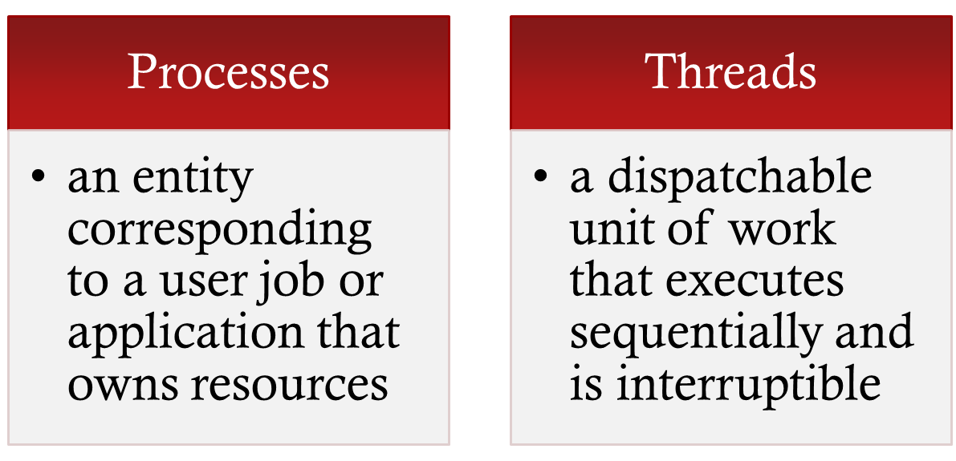
Process and Thread
Objects
Windows makes use of two types of process-related objects:
Notes:
The object-oriented structure of Windows facilitates the development of a general- purpose process facility. Windows makes use of two types of process-related objects: processes and threads. A process is an entity corresponding to a user job or application that owns resources, such as memory and open files. A thread is a dispatchable unit of work that executes sequentially and is interruptible, so that the processor can turn to another thread.

Slide 38
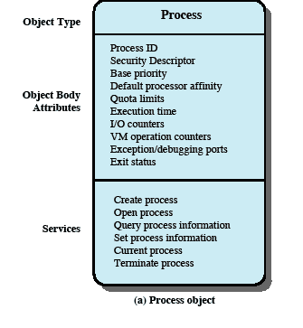
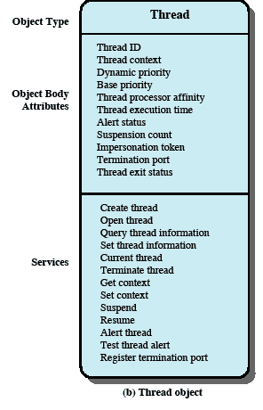
Windows Process and
Thread Objects
Notes:
Each Windows process is represented by an object whose general structure is shown in Figure 4.11a . Each process is defined by a number of attributes and encapsulates a number of actions, or services, that it may perform. A process will perform a service when called upon through a set of published interface methods. When Windows creates a new process, it uses the object class, or type, defined for the Windows process as a template to generate a new object instance. At the time of creation, attribute values are assigned.
Figure 4.11b depicts the object structure for a thread object.

Slide 39

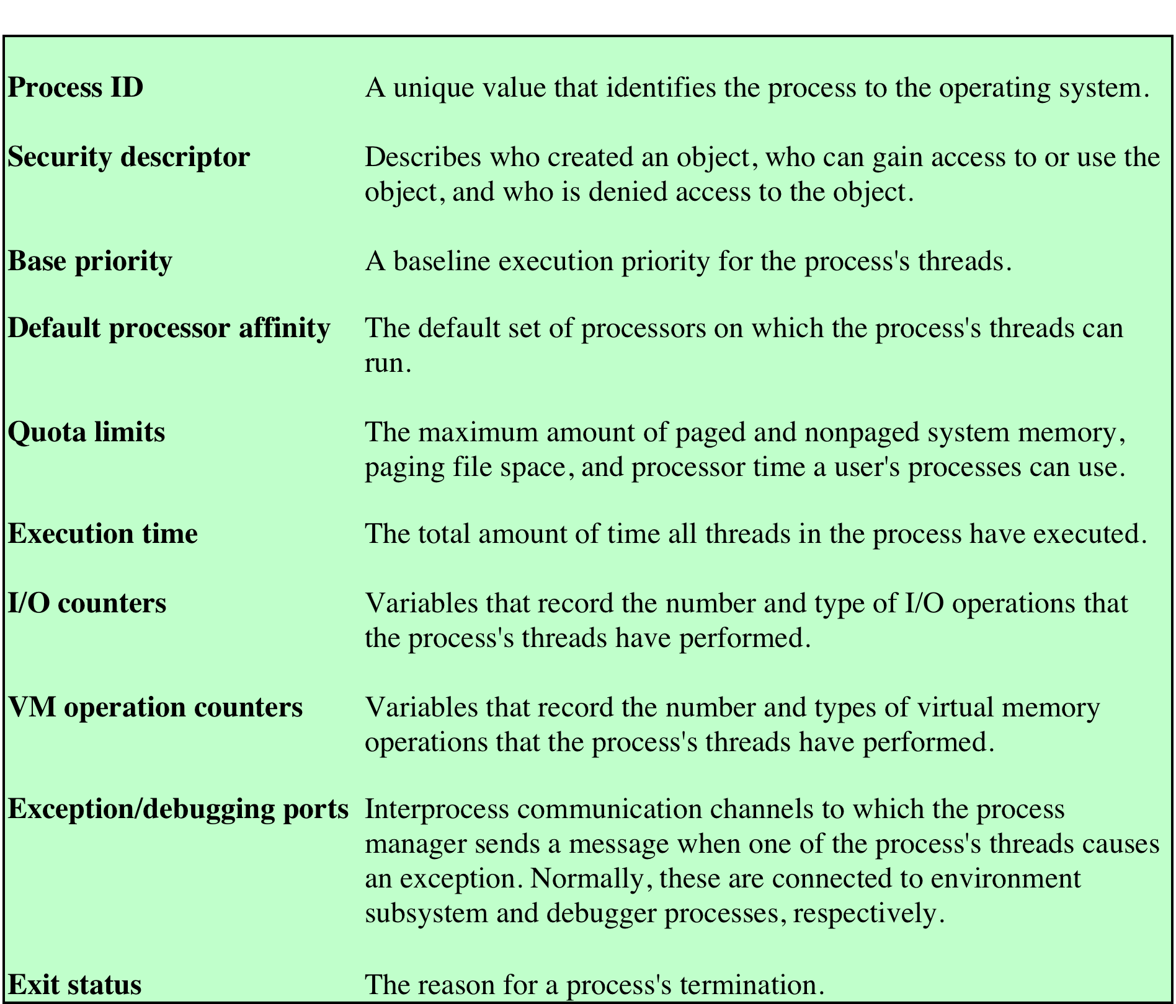
Windows Process Object Attributes
Table 4.3 Windows Process Object Attributes
Notes:
Table 4.3 gives a brief definition of each of the object attributes for a process object.

Slide 40
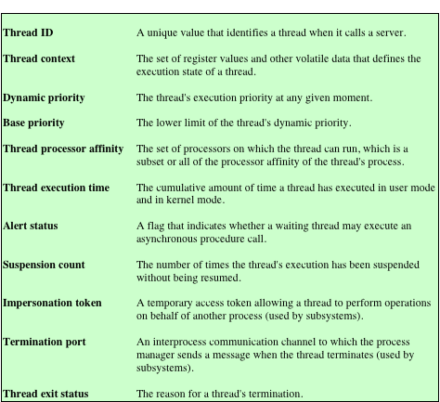
Windows Thread Object
Attributes
Table 4.4 Windows Thread Object Attributes
Notes:
A Windows process must contain at least one thread to execute. That thread may then create other threads. In a multiprocessor system, multiple threads from the same process may execute in parallel. Figure 4.11b depicts the object structure for a thread object, and Table 4.4 defines the thread object attributes. Note that some of the attributes of a thread resemble those of a process. In those cases, the thread attribute value is derived from the process attribute value. For example, the thread processor affinity is the set of processors in a multiprocessor system that may execute this thread; this set is equal to or a subset of the process processor affinity.
Note that one of the attributes of a thread object is context, which contains the values of the processor registers when the thread last ran. This information enables threads to be suspended and resumed. Furthermore, it is possible to alter the behavior of a thread by altering its context while it is suspended.

Slide 41
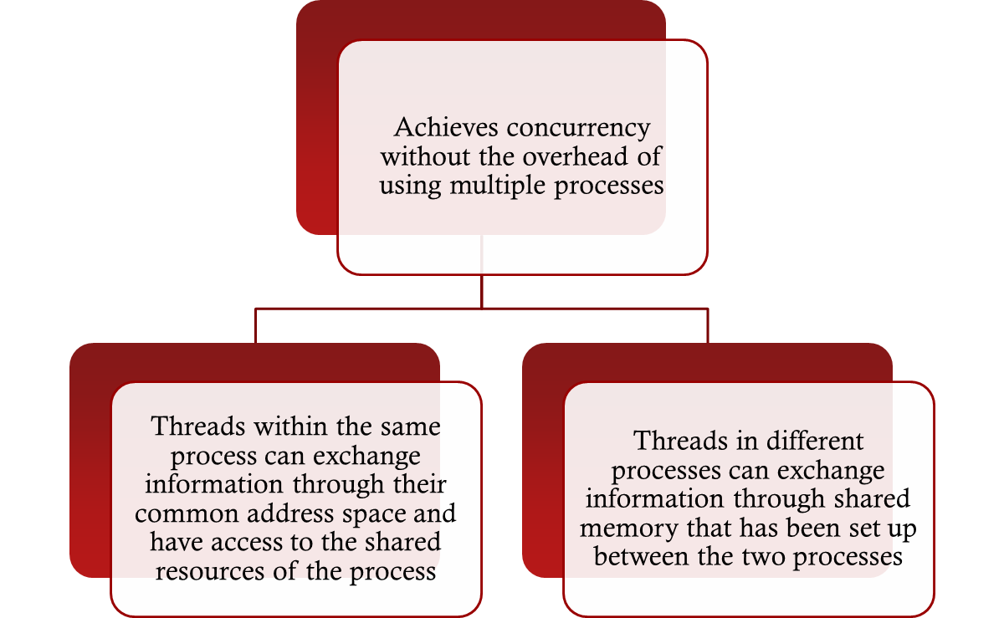

Multithreaded Process
Notes:
Windows supports concurrency among processes because threads in different processes may execute concurrently (appear to run at the same time). Moreover, multiple threads within the same process may be allocated to separate processors and execute simultaneously (actually run at the same time). A multithreaded process achieves concurrency without the overhead of using multiple processes. Threads within the same process can exchange information through their common address space and have access to the shared resources of the process. Threads in different processes can exchange information through shared memory that has been set up between the two processes.
An object-oriented multithreaded process is an efficient means of implementing a server application. For example, one server process can service a number of clients concurrently.

Slide 42
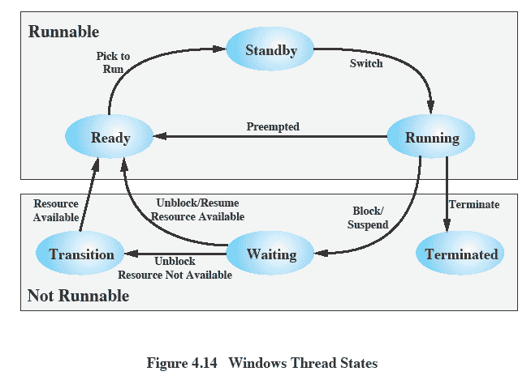
Thread States
Figure 4.12 Windows Thread States
Notes:
An existing Windows thread is in one of six states ( Figure 4.12 ):
• Ready: A ready thread may be scheduled for execution. The Kernel dispatcher
keeps track of all ready threads and schedules them in priority order.
• Standby: A standby thread has been selected to run next on a particular processor.
The thread waits in this state until that processor is made available. If the standby thread’s priority is high enough, the running thread on that processor may be preempted in favor of the standby thread. Otherwise, the standby thread waits until the running thread blocks or exhausts its time slice.
• Running: Once the Kernel dispatcher performs a thread switch, the standby
thread enters the Running state and begins execution and continues execution until it is preempted by a higher-priority thread, exhausts its time slice, blocks, or terminates. In the first two cases, it goes back to the Ready state.
• Waiting: A thread enters the Waiting state when (1) it is blocked on an event
(e.g., I/O), (2) it voluntarily waits for synchronization purposes, or (3) an environment subsystem directs the thread to suspend itself. When the waiting
condition is satisfied, the thread moves to the Ready state if all of its resources are available.
• Transition: A thread enters this state after waiting if it is ready to run but the
resources are not available. For example, the thread’s stack may be paged out of memory. When the resources are available, the thread goes to the Ready state.
• Terminated: A thread can be terminated by itself, by another thread, or when
its parent process terminates. Once housekeeping chores are completed, the thread is removed from the system, or it may be retained by the Executive 6 for future re-initialization.

Slide 43
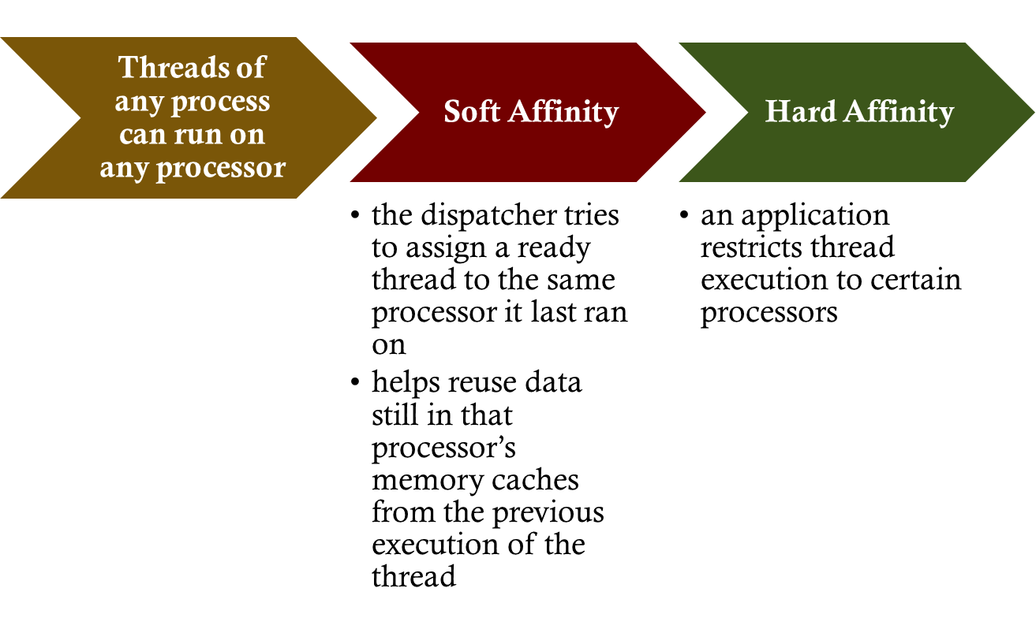


Symmetric Multiprocessing Support (SMP)
Notes:
Windows supports SMP hardware configurations. The threads of any process, including those of the executive, can run on any processor. In the absence of affinity restrictions, explained in the next paragraph, the kernel dispatcher assigns a ready thread to the next available processor. This assures that no processor is idle or is executing a lower-priority thread when a higher-priority thread is ready. Multiple threads from the same process can be executing simultaneously on multiple processors.
As a default, the kernel dispatcher uses the policy of soft affinity in assigning threads to processors: The dispatcher tries to assign a ready thread to the same processor it last ran on. This helps reuse data still in that processor’s memory caches from the previous execution of the thread. It is possible for an application to restrict its thread execution only to certain processors ( hard affinity ).

Slide 44
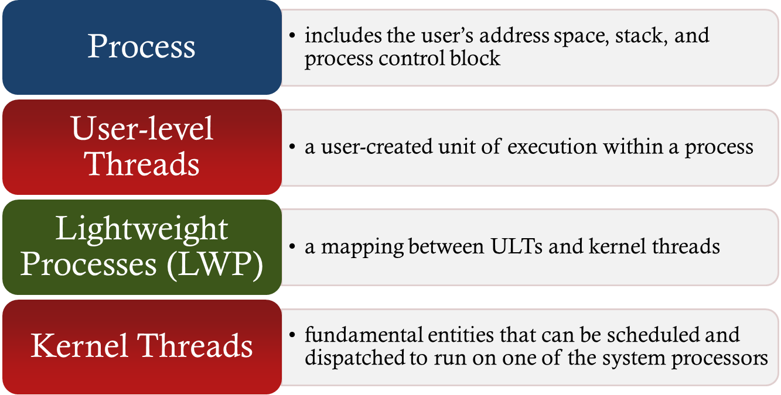
Solaris Process
- makes use of four thread-related concepts:
Notes:
Solaris makes use of four separate thread-related concepts:
• Process: This is the normal UNIX process and includes the user’s address
space, stack, and process control block.
• User-level threads: Implemented through a threads library in the address
space of a process, these are invisible to the OS. A user-level thread (ULT) 7 is a user-created unit of execution within a process.
• Lightweight processes: A lightweight process (LWP) can be viewed as a mapping
between ULTs and kernel threads. Each LWP supports ULT and maps to one kernel thread. LWPs are scheduled by the kernel independently and may execute in parallel on multiprocessors.
• Kernel threads: These are the fundamental entities that can be scheduled and
dispatched to run on one of the system processors.

Slide 45
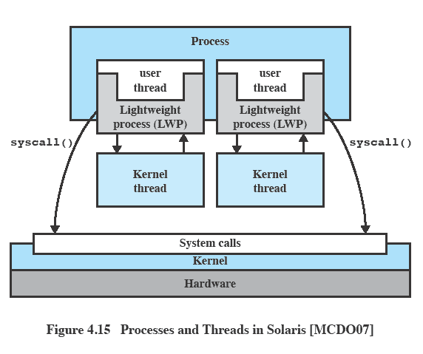
Processes and Threads in Solaris
Figure 4.13 Processes and Threads in Solaris [MCDO07]
Notes:
Figure 4.13 illustrates the relationship among these four entities. Note that there is always exactly one kernel thread for each LWP. An LWP is visible within a process to the application. Thus, LWP data structures exist within their respective process address space. At the same time, each LWP is bound to a single dispatchable kernel thread, and the data structure for that kernel thread is maintained within the kernel’s address space.
A process may consist of a single ULT bound to a single LWP. In this case, there is a single thread of execution, corresponding to a traditional UNIX process. When concurrency is not required within a single process, an application uses this process structure. If an application requires concurrency, its process contains multiple threads, each bound to a single LWP, which in turn are each bound to a single kernel thread.
In addition, there are kernel threads that are not associated with LWPs. The kernel creates, runs, and destroys these kernel threads to execute specific system functions. The use of kernel threads rather than kernel processes to implement system functions reduces the overhead of switching within the kernel (from a process switch to a thread switch).

Slide 46
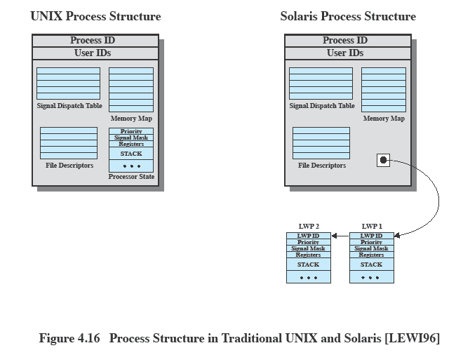

Traditional Unix vs Solaris
Figure 4.14 Process Structure in Traditional UNIX and Solaris [LEWI96]
Notes:
Figure 4.14 compares, in general terms, the process structure of a traditional UNIX system with that of Solaris. On a typical UNIX implementation, the process structure includes the process ID; the user IDs; a signal dispatch table, which the kernel uses to decide what to do when sending a signal to a process; file descriptors, which describe the state of files in use by this process; a memory map, which defines the address space for this process; and a processor state structure, which includes the kernel stack for this process. Solaris retains this basic structure but replaces the processor state block with a list of structures containing one data block for each LWP.

Slide 47

A Lightweight Process (LWP) Data Structure Includes:
An LWP identifier
The priority of this LWP
A signal mask
Saved values of user-level registers
The kernel stack for this LWP
Resource usage and profiling data
Pointer to the corresponding kernel thread
Pointer to the process structure
Notes:
The LWP data structure includes the following elements:
• An LWP identifier
• The priority of this LWP and hence the kernel thread that supports it
• A signal mask that tells the kernel which signals will be accepted
• Saved values of user-level registers (when the LWP is not running)
• The kernel stack for this LWP, which includes
system call arguments,
- results, and
- error codes for each call level
• Resource usage and profiling data
• Pointer to the corresponding kernel thread
• Pointer to the process structure

Slide 48
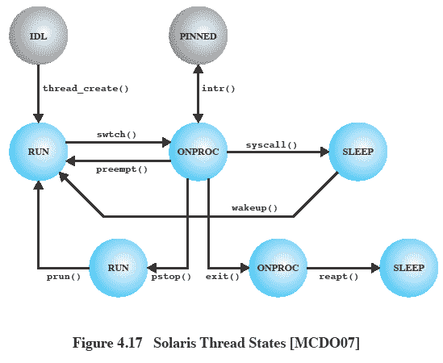
Solaris Thread States
Figure 4.15 Solaris Thread States
Notes:
Figure 4.15 shows a simplified view of both thread execution states. These states reflect the execution status of both a kernel thread and the LWP bound to it. As mentioned, some kernel threads are not associated with an LWP; the same execution diagram applies. The states are as follows:
• RUN: The thread is runnable; that is, the thread is ready to execute.
• ONPROC: The thread is executing on a processor.
• SLEEP: The thread is blocked.
• STOP: The thread is stopped.
• ZOMBIE: The thread has terminated.
• FREE: Thread resources have been released and the thread is awaiting removal from the OS thread data structure.
A thread moves from ONPROC to RUN if it is preempted by a higher-priority thread or because of time slicing. A thread moves from ONPROC to SLEEP if it is blocked and must await an event to return the RUN state. Blocking occurs if the thread invokes a system call and must wait for the system service to be performed. A thread enters the STOP state if its process is stopped; this might be done for debugging purposes.

Slide 49
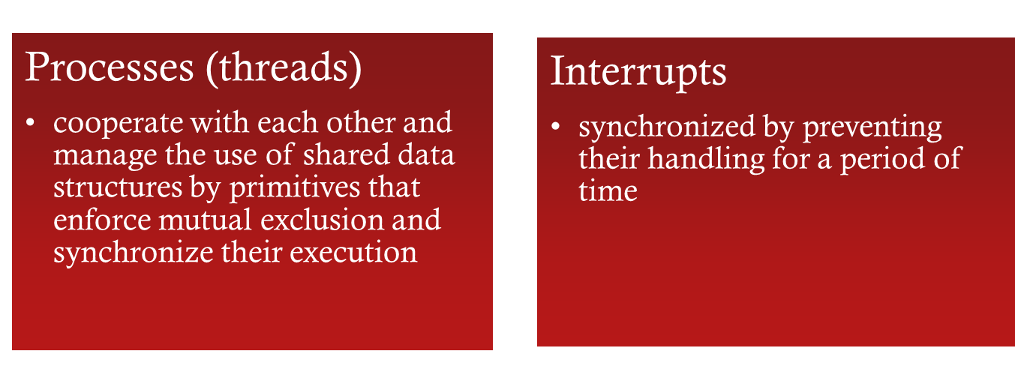
Interrupts as Threads
Most operating systems contain two fundamental forms of concurrent activity:
Notes:
Most operating systems contain two fundamental forms of concurrent activity: processes and interrupts. Processes (or threads) cooperate with each other and manage the use of shared data structures by means of a variety of primitives that enforce mutual exclusion (only one process at a time can execute certain code or access certain data) and that synchronize their execution. Interrupts are synchronized by preventing their handling for a period of time. Solaris unifies these two concepts into a single model, namely kernel threads and the mechanisms
for scheduling and executing kernel threads. To do this, interrupts are converted to kernel threads.
The motivation for converting interrupts to threads is to reduce overhead. Interrupt handlers often manipulate data shared by the rest of the kernel. Therefore, while a kernel routine that accesses such data is executing, interrupts must be blocked, even though most interrupts will not affect that data. Typically, the way this is done is for the routine to set the interrupt priority level higher to block interrupts and then lower the priority level after access is completed. These operations take time. The problem is magnified on a multiprocessor system. The kernel must protect more objects and may need to block interrupts on all processors.

Slide 50
Solaris Solution
Solaris employs a set of kernel threads to handle interrupts
    an interrupt thread has its own identifier, priority, context, and stack
    the kernel controls access to data structures and synchronizes among interrupt threads using mutual exclusion primitives
    interrupt threads are assigned higher priorities than all other types of kernel threads
Notes:
When an interrupt occurs, it is delivered to a particular processor and the thread that was executing on that processor is pinned. A pinned thread cannot move to another processor and its context is preserved; it is simply suspended until the interrupt is processed. The processor then begins executing an interrupt thread. There is a pool of deactivated interrupt threads available, so that a new thread creation is not required. The interrupt thread then executes to handle the interrupt. If the handler routine needs access to a data structure that is currently locked in some fashion for use by another executing thread, the interrupt thread must wait for access to that data structure. An interrupt thread can only be preempted by another
interrupt thread of higher priority.
Experience with Solaris interrupt threads indicates that this approach provides superior performance to the traditional interrupt-handling strategy [KLEI95].

Slide 51
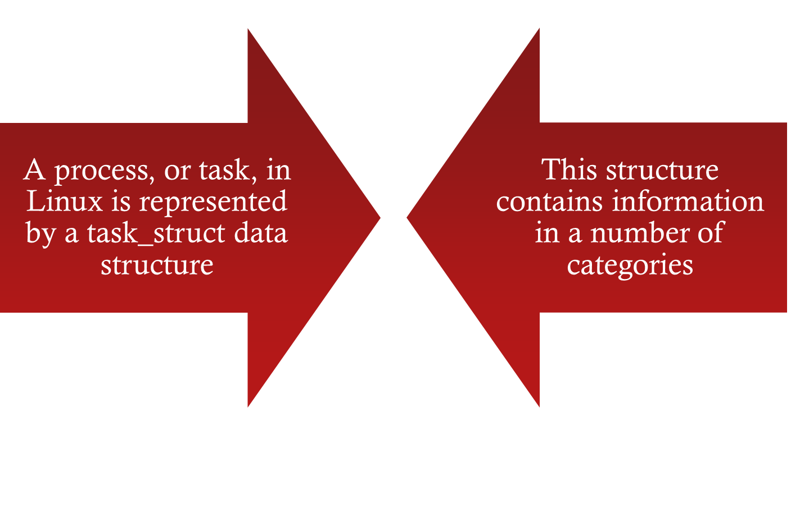

Linux Tasks
Notes:
A process, or task, in Linux is represented by a task_struct data structure. The task_struct data structure contains information in a number of categories:
• State:
The execution state of the process (executing, ready, suspended, stopped, zombie). This is described subsequently.
• Scheduling information:
Information needed by Linux to schedule processes. A process can be normal or real time and has a priority. Real-time processes are scheduled before normal processes, and within each category, relative priorities can be used. A counter keeps track of the amount of time a process is allowed to execute.
• Identifiers:
Each process has a unique process identifier and also has user and group identifiers. A group identifier is used to assign resource access privileges to a group of processes.
• Interprocess communication:
Linux supports the IPC mechanisms found in UNIX SVR4, described in Chapter 6 .
• Links:
Each process includes a link to its parent process, links to its siblings (processes with the same parent), and links to all of its children.
Times and timers:
Includes process creation time and the amount of processor time so far consumed by the process. A process may also have associated one or more interval timers. A process defines an interval timer by means of a system call; as a result, a signal is sent to the process when the timer expires. A timer may be single use or periodic.
• File system:
Includes pointers to any files opened by this process, as well as pointers to the current and the root directories for this process.
• Address space:
Defines the virtual address space assigned to this process.
• Processor-specific context:
The registers and stack information that constitute the context of this process.

Slide 52
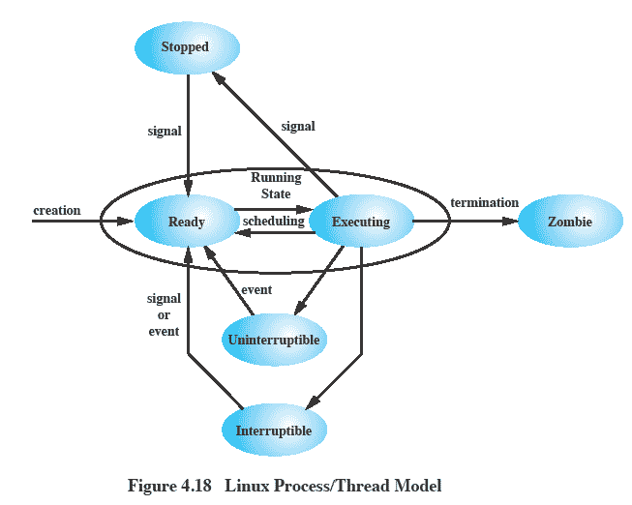
Linux
Process/Thread Model
Figure 4.16 Linux Process/Thread Model
Notes:
Running:
Corresponds to two states.
A Running process is either executing or
it is ready to execute.
Interruptible:
A blocked state, in which the process is waiting for an event, such as the end of an I/O operation, the availability of a resource, or a signal from another process.
Uninterruptible:
Another blocked state.
The difference between the Interruptible state is that in this state, a process is waiting directly on hardware conditions and therefore will not handle any signals.
Stopped:
The process has been halted and can only resume by positive action from another process.
E.G., a process that is being debugged can be put into the Stopped state.
Zombie:
The process has been terminated but, for some reason, still must have its task structure in the process table.

Slide 53
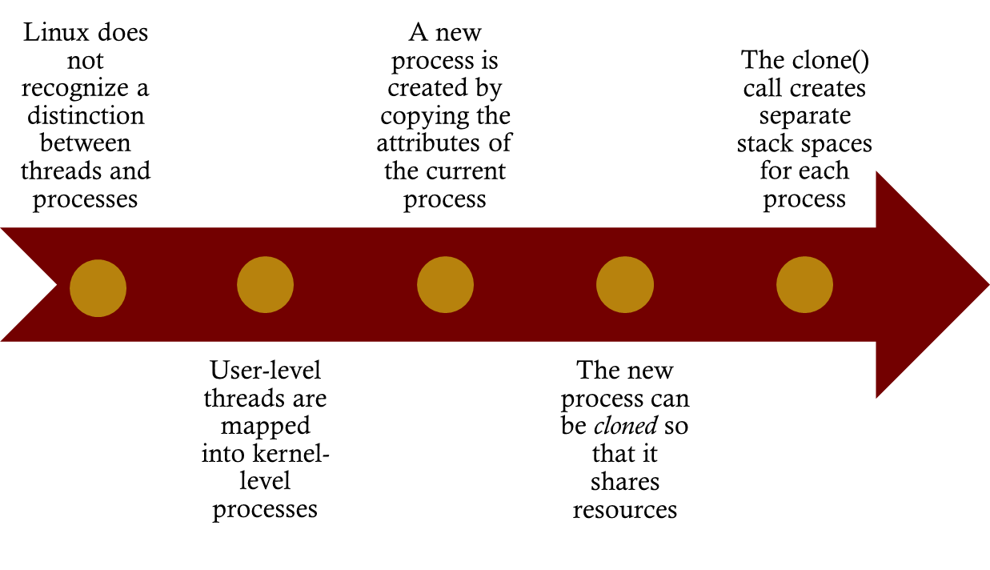
Linux Threads
Notes:
Traditional UNIX systems support a single thread of execution per process, while modern UNIX systems typically provide support for multiple kernel-level threads per process. As with traditional UNIX systems, older versions of the Linux kernel offered no support for multithreading. Instead, applications would need to be written with a set of user-level library functions, the most popular of which is known as pthread (POSIX thread) libraries , with all of the threads mapping into a single kernel-level process. 8 We have seen that modern versions of UNIX offer kernel-level threads. Linux provides a unique solution in that it does not recognize a distinction between threads and processes. Using a mechanism similar to the lightweight processes of Solaris, user-level threads are mapped into kernel-level processes. Multiple user-level threads that constitute a single user-level process are mapped into Linux kernel-level processes that share the same group ID. This enables these processes to share resources such as files and memory and to avoid the need for a context switch when the scheduler switches among processes in the same group.
A new process is created in Linux by copying the attributes of the current process. A new process can be cloned so that it shares resources, such as files, signal handlers, and virtual memory. When the two processes share the same virtual memory, they function as threads within a single process. However, no separate type of data structure is defined for a thread. In place of the usual fork() command, processes are created in Linux using the clone() command. This command includes a set of flags as arguments, defined in Table 4.5 . The traditional fork() system call is implemented by Linux as a clone() system call with all of the clone flags cleared.
When the Linux kernel performs a switch from one process to another, it checks whether the address of the page directory of the current process is the same as that of the to-be-scheduled process. If they are, then they are sharing the same address space, so that a context switch is basically just a jump from one location of code to another location of code.
Although cloned processes that are part of the same process group can share the same memory space, they cannot share the same user stacks. Thus the clone() call creates separate stack spaces for each process.

Slide 54
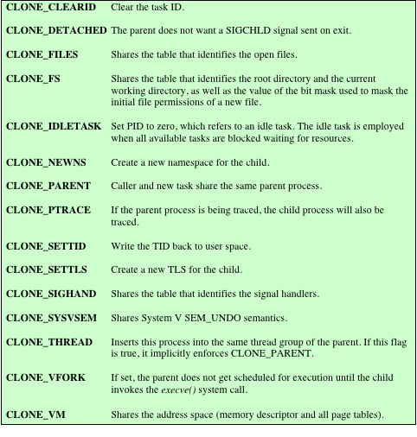

Linux
Clone ()
Flags
Notes:
Table 4.5, Linux clone () flags.

Slide 55

Mac OS X Grand Central Dispatch (GCD)
Provides a pool of available threads
Designers can designate portions of applications, called blocks, that can be dispatched independently and run concurrently
Concurrency is based on the number of cores available and the thread capacity of the system
Notes:
As was mentioned in Chapter 2 , Mac OS X Grand Central Dispatch (GCD) provides a pool of available threads. Designers can designate portions of applications, called blocks, that can be dispatched independently and run concurrently. The OS will provide as much concurrency as possible based on the number of cores available and the thread capacity of the system. Although other operating systems have implemented thread pools, GCD provides a qualitative improvement in ease of use and efficiency.

Slide 56



    A simple extension to a language
    A block defines a self-contained unit of work
    Enables the programmer to encapsulate complex functions
    Scheduled and dispatched by queues
    Dispatched on a first-in-first-out basis
    Can be associated with an event source, such as a timer, network socket, or file descriptor
Notes:
As was mentioned in Chapter 2 , Mac OS X Grand Central Dispatch (GCD) provides a pool of available threads. Designers can designate portions of applications, called blocks, that can be dispatched independently and run concurrently. The OS will provide as much concurrency as possible based on the number of cores available and the thread capacity of the system. Although other operating systems have implemented thread pools, GCD provides a qualitative improvement in ease of use and efficiency.
A block is a simple extension to C or other languages, such as C++. The purpose of defining a block is to define a self-contained unit of work, including code plus data. Here is a simple example of a block definition:
x = ^{ printf(“hello world\n”); }
A block is denoted by a caret at the start of the function, which is enclosed in curly brackets. The above block definition defines x as a way of calling the function, so that invoking the function x() would print the words hello world.
Blocks enable the programmer to encapsulate complex functions, together with their arguments and data, so that they can easily be referenced and passed around in a program, much like a variable.
Blocks are scheduled and dispatched by means of queues. The application makes use of system queues provided by GCD and may also set up private queues. Blocks are put onto a queue as they are encountered during program execution. GCD then uses those queues to describe concurrency, serialization, and callbacks. Queues are lightweight user-space data structures, which generally makes them far more efficient than manually managing threads and locks.
Depending on the queue and how it is defined, GCD either treats these blocks as potentially concurrent activities, or treats them as serial activities. In either case, blocks are dispatched on a first-in-first-out basis. If this is a concurrent queue, then the dispatcher assigns F to a thread as soon as one is available, then G, then H. If
this is a serial queue, the dispatcher assigns F to a thread, and then only assigns G to a thread after F has completed.
The use of predefined threads saves the cost of creating a new thread for each request, reducing the latency associated with processing a block. Thread pools are automatically sized by the system to maximize the performance of the applications using GCD while minimizing the number of idle or competing threads.
In addition to scheduling blocks directly, the application can associate a single block and queue with an event source, such as a timer, network socket, or file descriptor. Every time the source issues an event, the block is scheduled if it is not already running. This allows rapid response without the expense of polling or “parking a thread” on the event source.

Slide 57

Summary
User-level threads
  created and managed by a threads library that runs in the user space of a process
  a mode switch is not required to switch from one thread to another
  only a single user-level thread within a process can execute at a time
  if one thread blocks, the entire process is blocked
Kernel-level threads
  threads within a process that are maintained by the kernel
  a mode switch is required to switch from one thread to another
  multiple threads within the same process can execute in parallel on a multiprocessor
  blocking of a thread does not block the entire process
Process/related to resource ownership
Thread/related to program execution
Notes:
Some operating systems distinguish the concepts of process and thread, the former related to resource ownership and the latter related to program execution. This approach may lead to improved efficiency and coding convenience. In a multithreaded system, multiple concurrent threads may be defined within a single process. This may be done using either user-level threads or kernel-level threads. User-level threads are unknown to the OS and are created and managed by a threads library that runs in the user space of a process. User-level threads are very efficient because a mode switch is not required to switch from one thread to another. However, only a single user-level thread within a process can execute at a time, and if one thread blocks, the entire process is blocked. Kernel-level threads are threads within a process that are maintained by the kernel. Because they are recognized by the kernel, multiple threads within the same process can execute in parallel on a multiprocessor and the blocking of a thread does not block the entire process. However, a mode switch is required to switch from one thread to another.

